Slide 1
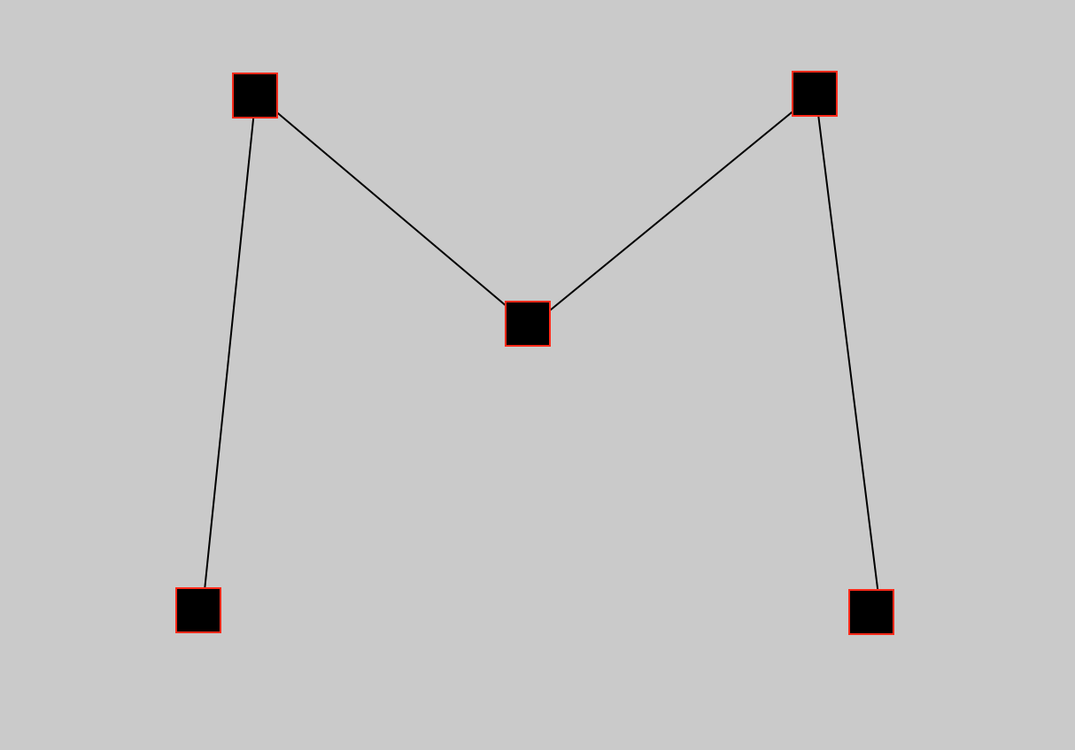
MazeBuilder
A tool for the PhenoSys Jetball

Slide 2
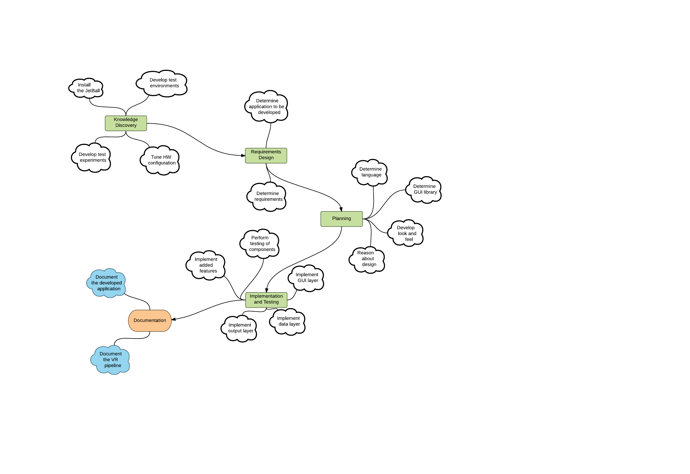
The path to MazeBuilder

Slide 3
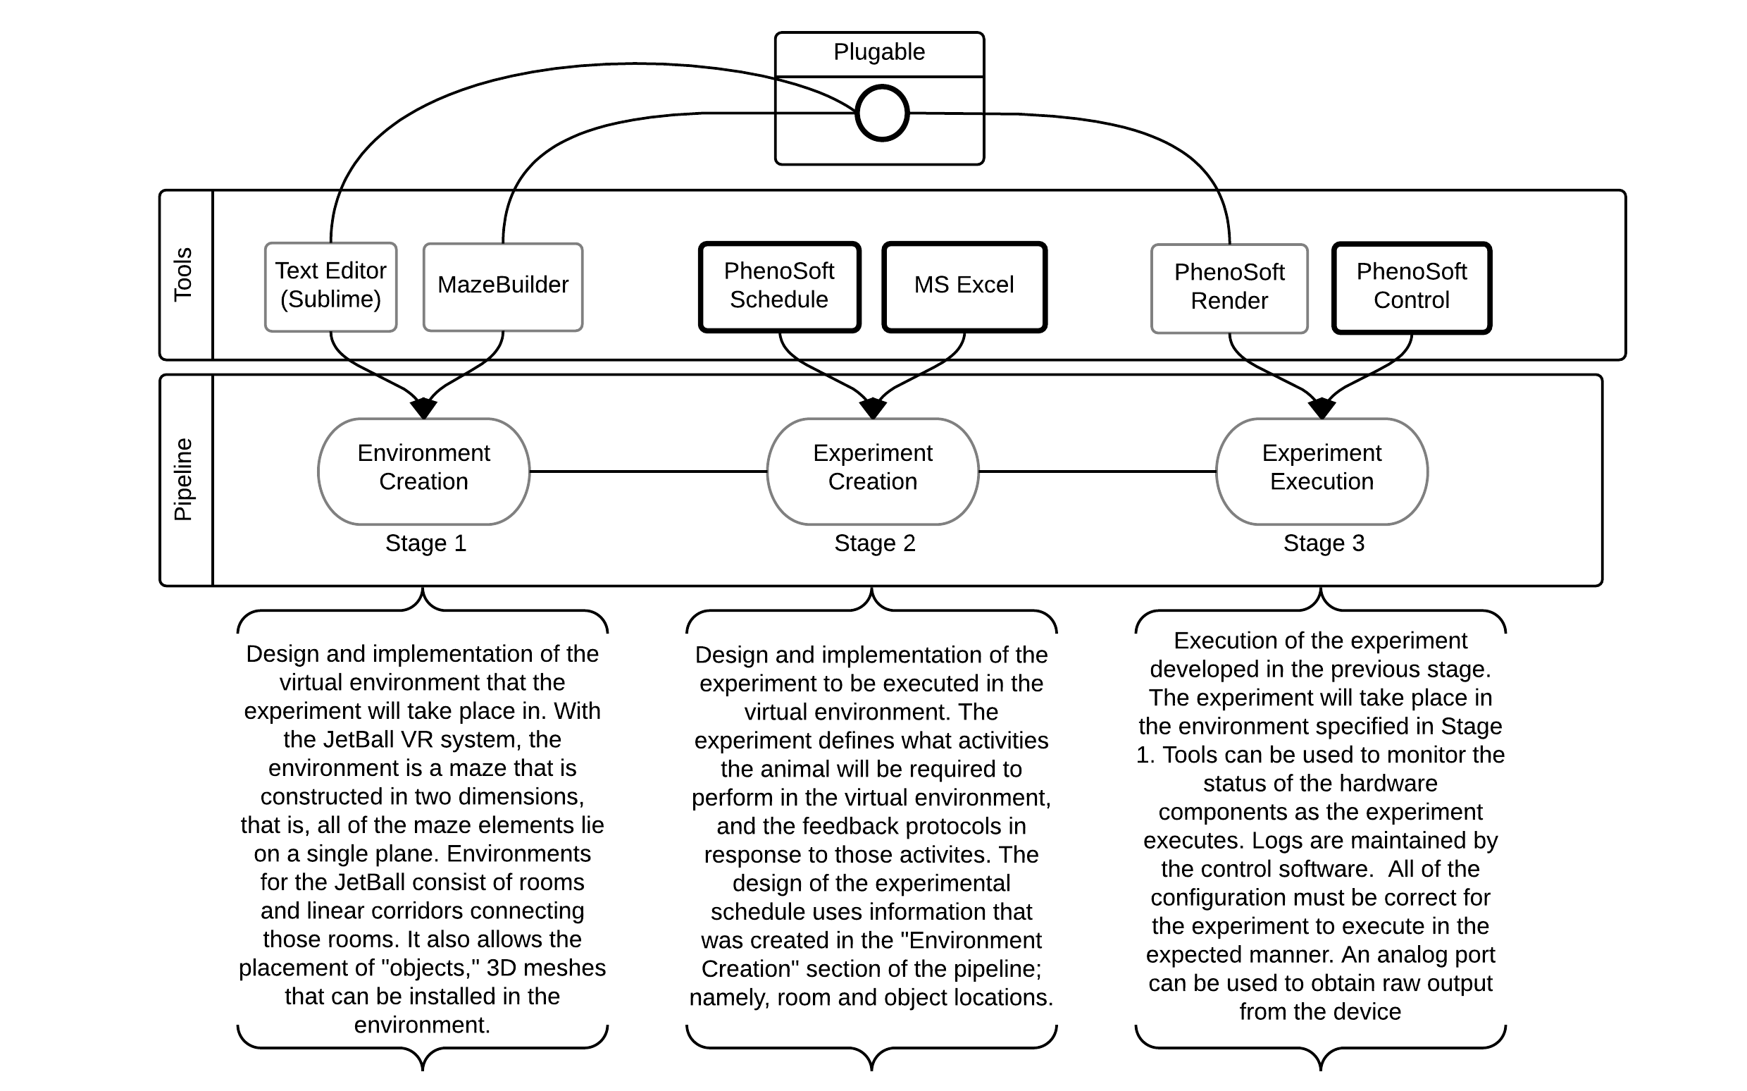
The VR Pipeline

Slide 4
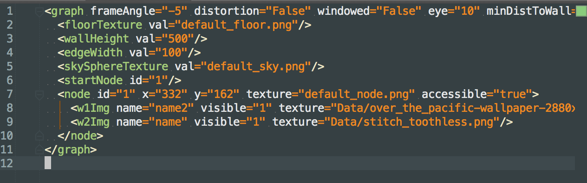
Without MazeBuilder
Raw editing of XML using a text editor
Extremely tedious and error prone, especially for large environments ( repetition complacency and cut&paste errors

Slide 5
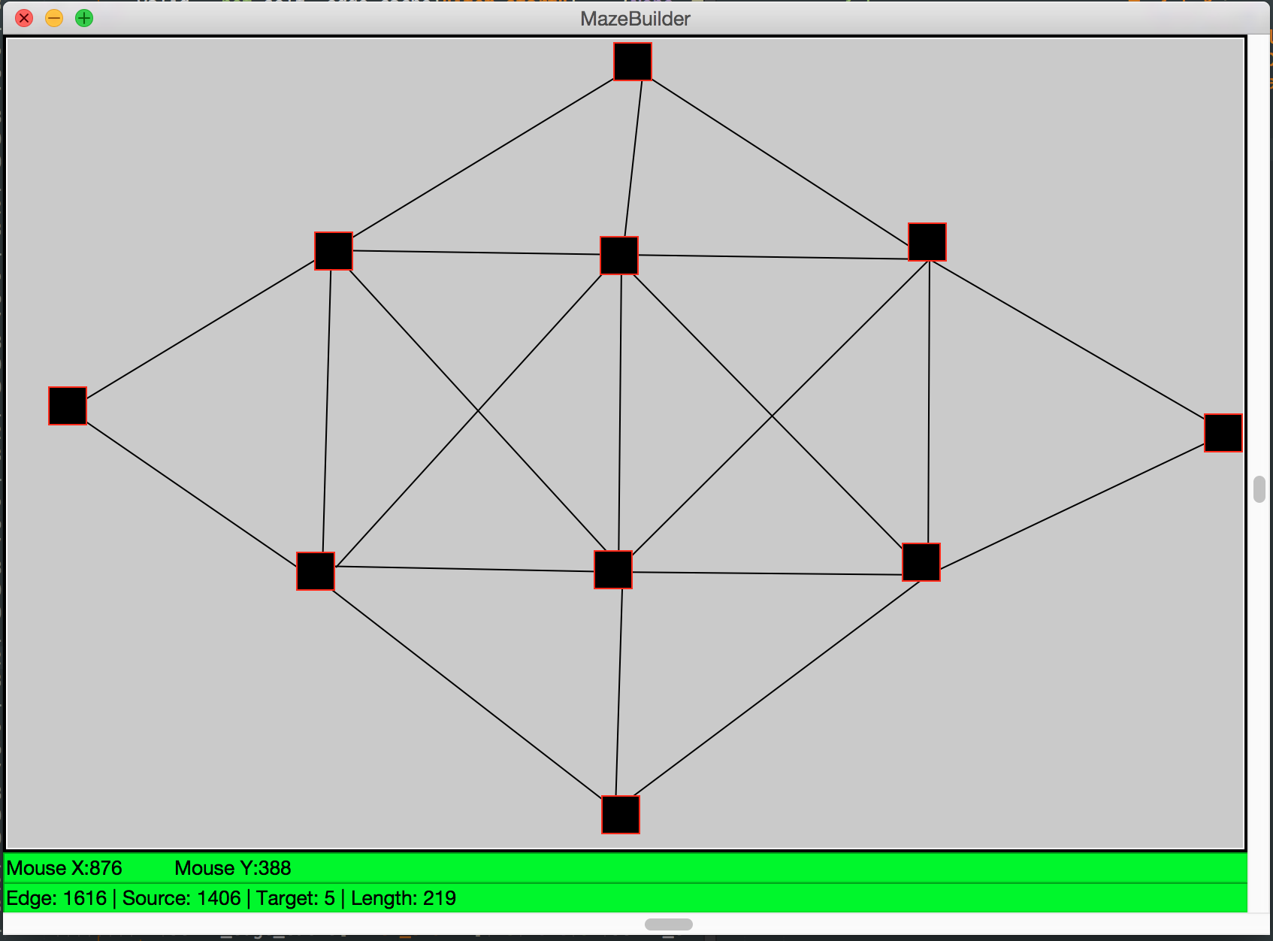
With MazeBuilder

Slide 6
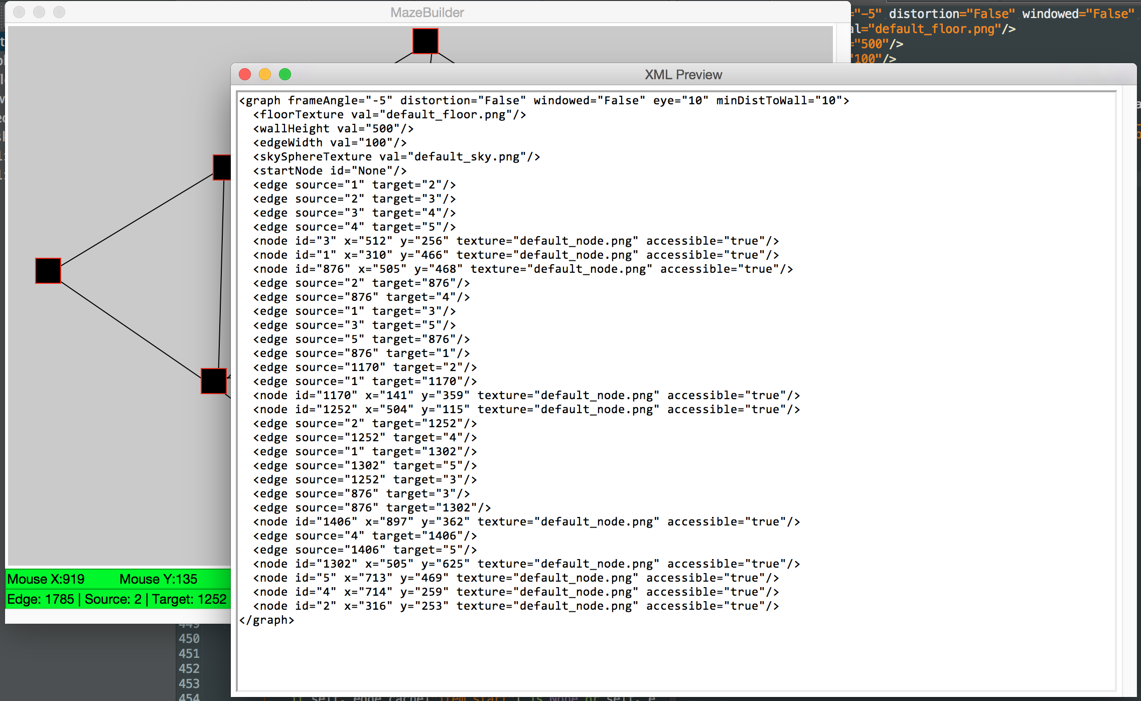
With MazeBuilder

Slide 7
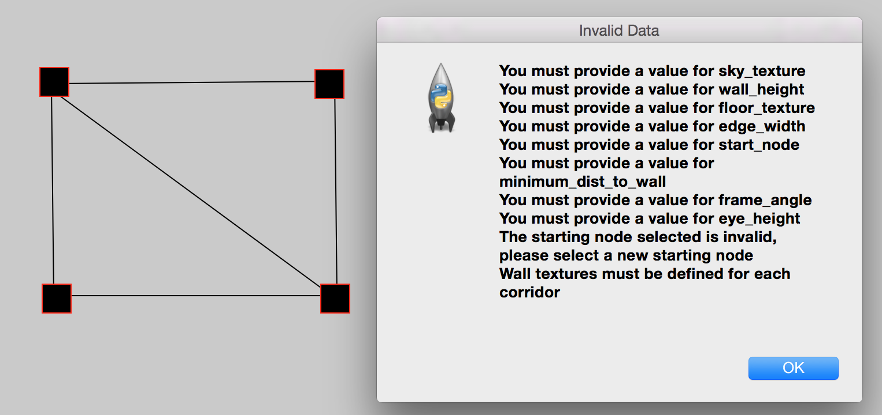
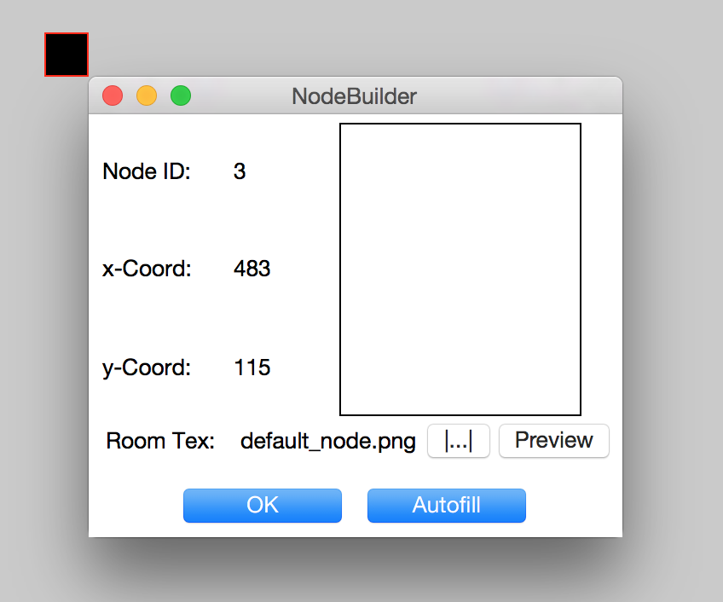
With MazeBuilder
Drag and Drop room creation and corridor creation
Pictures and textures auto-moved to correct folder
Data validation during editing and before file export
XML import to allow editing of pre-created mazes
Autopopulation of data fields
Real-time XML view

Slide 8
Live Demo
Which wont work because live tech demos never do

Slide 9
What’s left?
Write user documentation for MazeBuilder
Write documentation regarding the VR pipeline
Implementation of any additional features

Slide 10
Where to go next?
Investigate concept of “plugable” modules for the VR system e.g. Replacing the renderer used
Investigate the output provided by the JetBall, and how it could be used to interface with external systems
Development of tool to streamline experiment launching
Development of system to enact real-time changing of environment (in response to stimuli)

